Slide 1
California Housing
Market Update
Glendale Association of REALTORS®
Jordan G. Levine
Senior Vice President & Chief Economist
California Association of REALTORS®
June 6, 2024

Slide 2
We have entered the economic Twilight Zone
The Bad(?) News
Economy overperforming on jobs & GDP
Consumers still propelling economy
Things progressing as broadcast by Fed
The Good(?) News
Signs of cracks on jobs & spending
Credit card debt levels rising too fast
Office sector struggles getting worse
Where Does That Leave Us?
Bumpy road to recovery, but getting better
Inventory will continue to rise slowly
Many challenges, one answer—bring it!
Bottom line for 2024 & beyond
Market will break above 300K sales again
Prices will rise, rates down only a bit
The data really tells our story well—use it!

Slide 3
The Bad News Is The Economy is Still Strong

Slide 4
California labor market data telling 2 stories

Slide 5
Consumers remain the driving economic force

Slide 6
Inflation is inch by inch, don’t wait for rates
Notes:
Headline index increased 4.9% for the 12 months ending April, which was the smallest 12-month increase since the period ending April 2021.
Grocery store prices fell 0.2% in April and have now posted the first back-to-back monthly declines since the summer of 2019.

Slide 7
Rates responding to latest inflation report

Slide 8
Mortgage rates follow the 10-year upward
SERIES: Fed Funds Rate, Fed’s Dot Plot
SOURCE: Federal Reserve, the Wall Street Journal

Slide 9
The Good News is Might Not Be As Strong As It Appears

Slide 10
California labor market data telling 2 stories

Slide 11
Many sectors already down/plateauing in California

Slide 12
Something’s got to give with consumers eventually

Slide 13
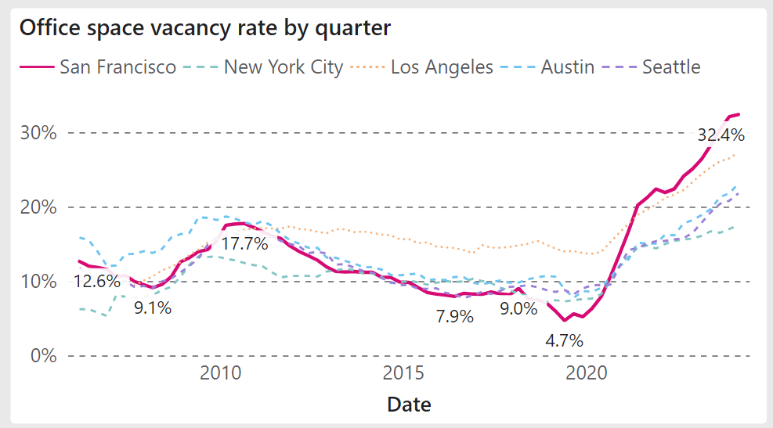

Slide 14
Rate cuts not ruled out yet
But let’s get serious about where rates are headed long term

Slide 15
Extrapolating the March “dot plot” from Fed meeting

Slide 16
A little perspective on interest rates is needed

Slide 17
Buyer demand very sensitive to rate changes

Slide 18
Sales are starting to bounce back already in 2024
Notes:
*Sales are seasonally adjusted and annualized

Slide 19
All of California starting off on a positive note

Slide 20
Top end rebounding more quickly once again

Slide 21
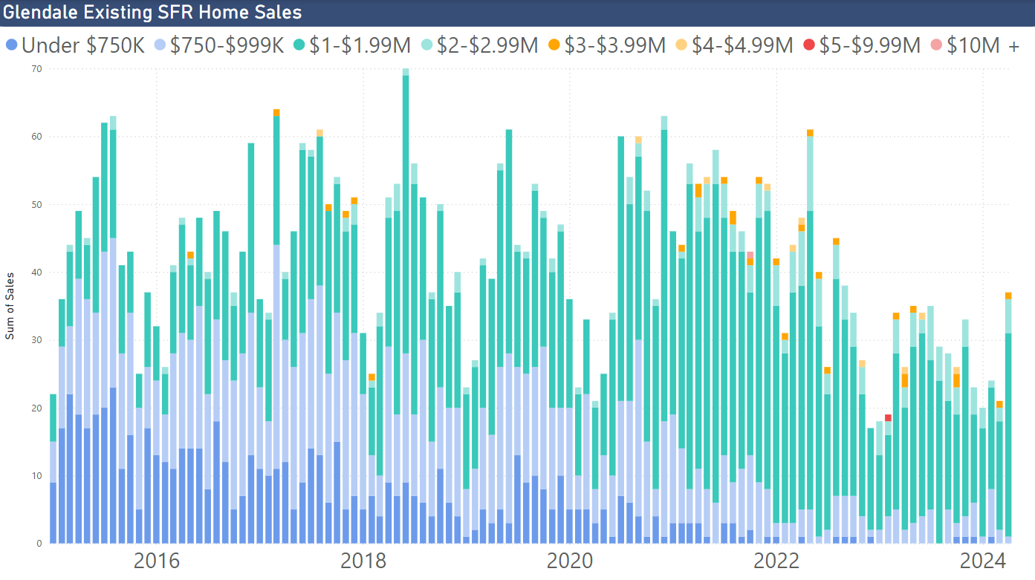

Slide 23
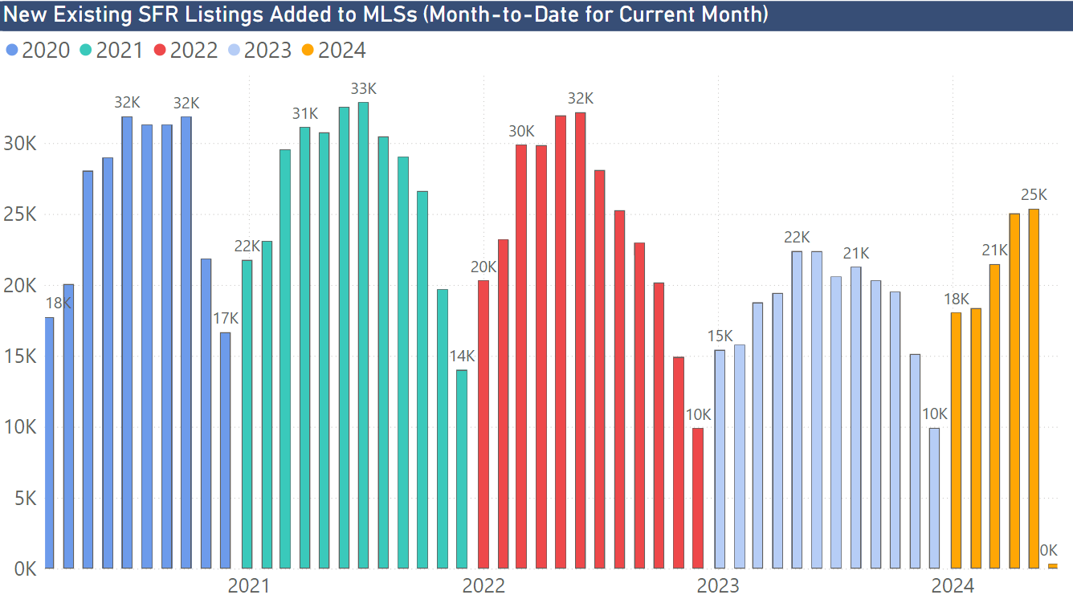

Slide 24
Rates are one thing, but life happens

Slide 25
Tight supply not going away

Slide 26
Lock-in effect on current owners from interest rates

Slide 27
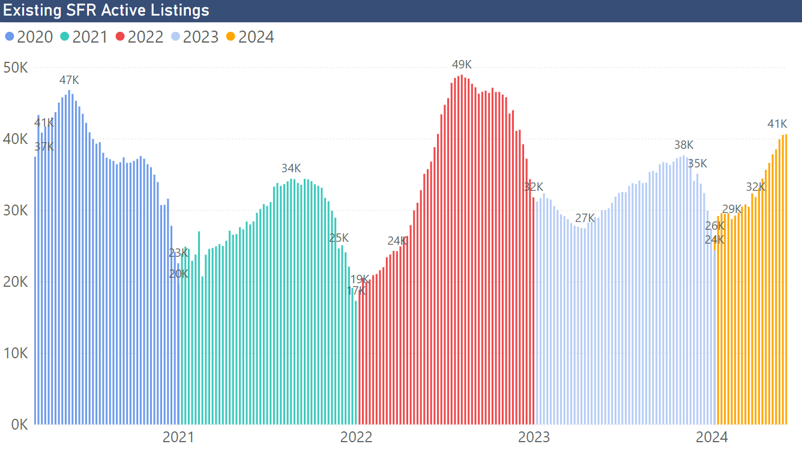

Slide 28
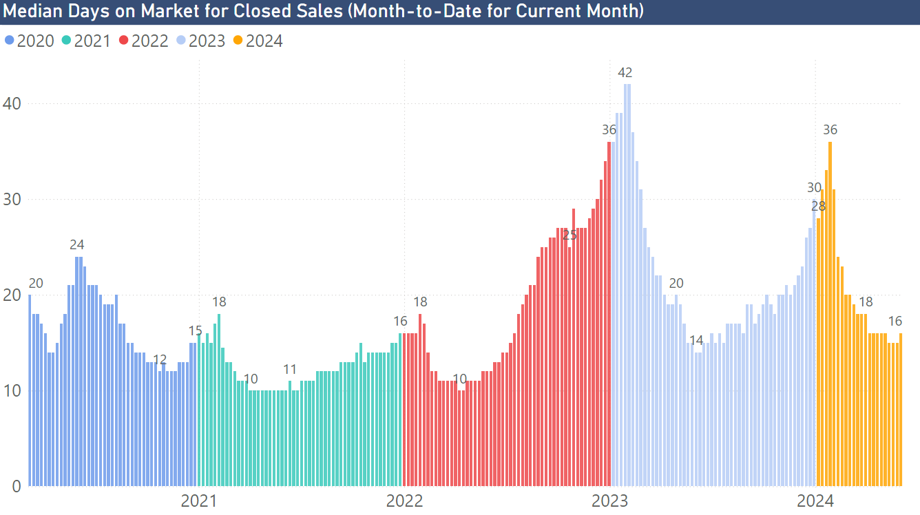

Slide 29
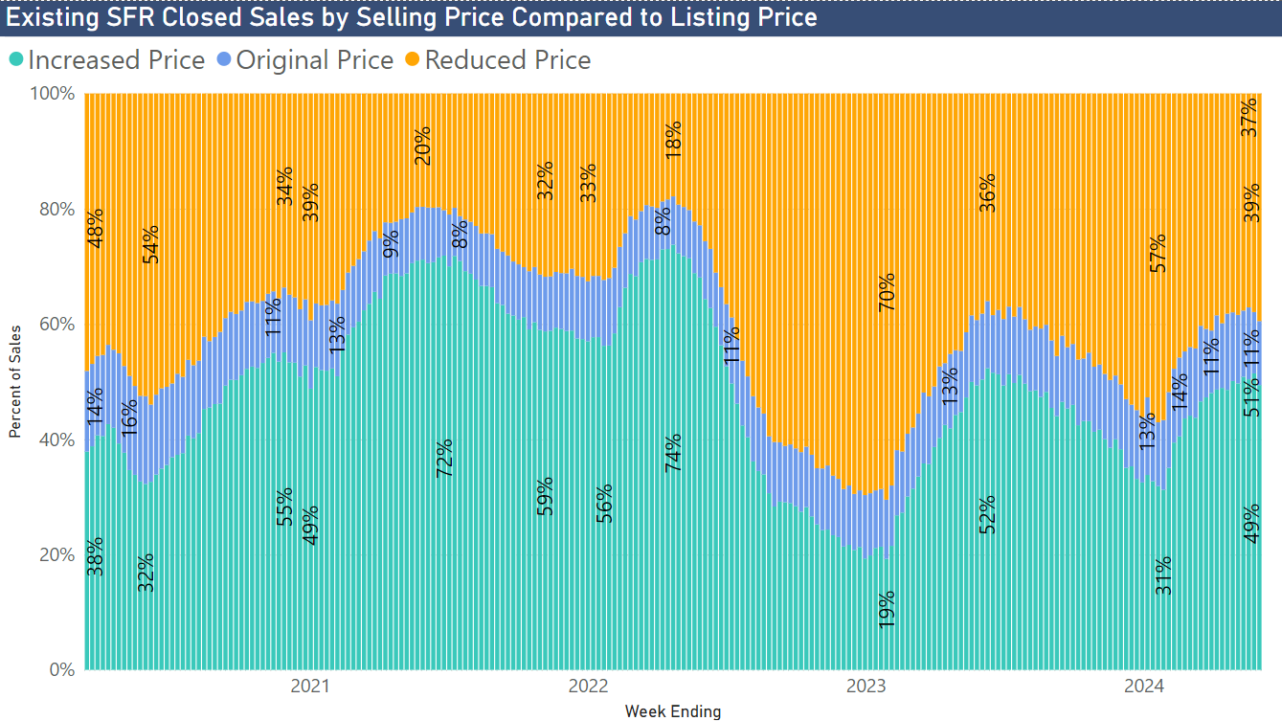

Slide 30
California price increases for 10th month in a row

Slide 31
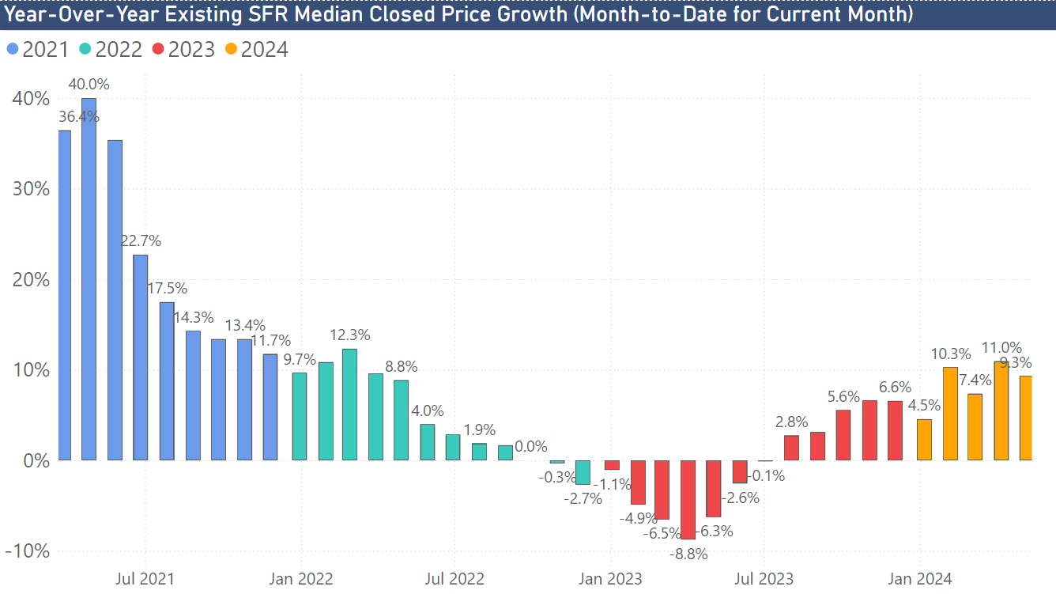

Slide 32
Sellers Need to Be More Strategic Now

Slide 33
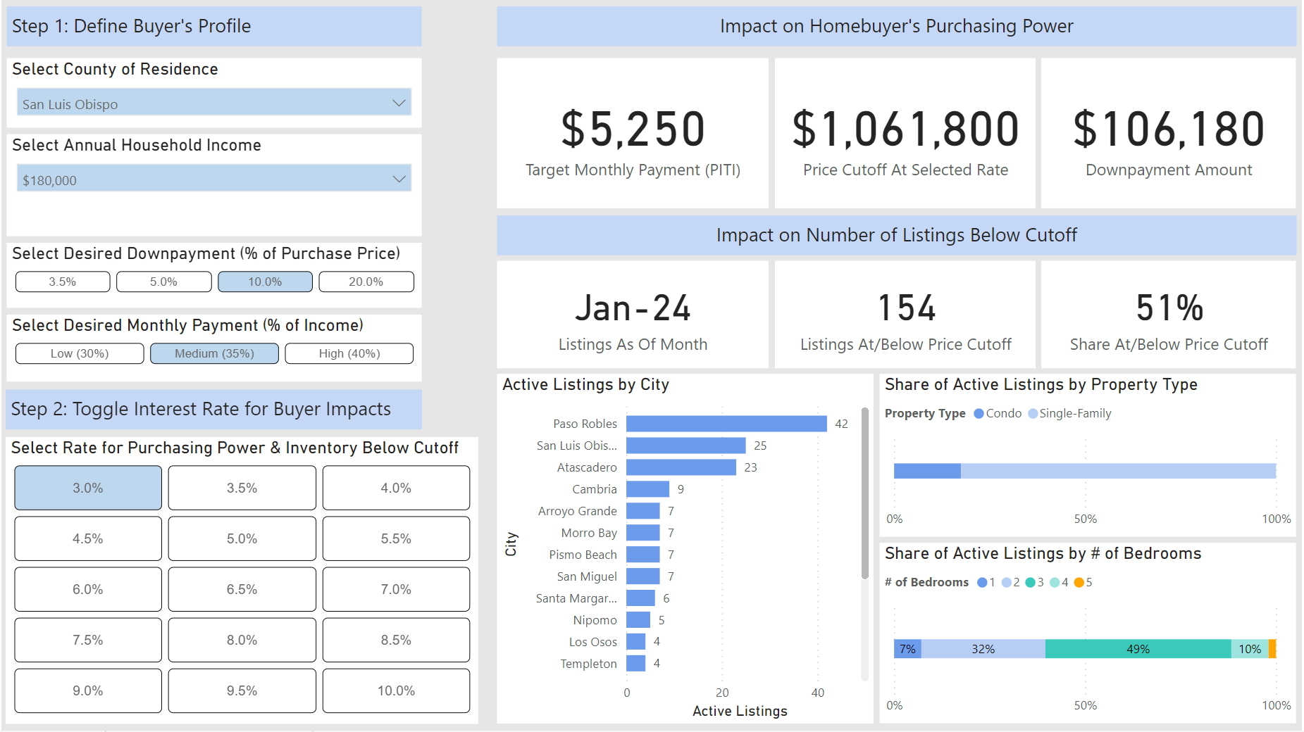

Slide 34
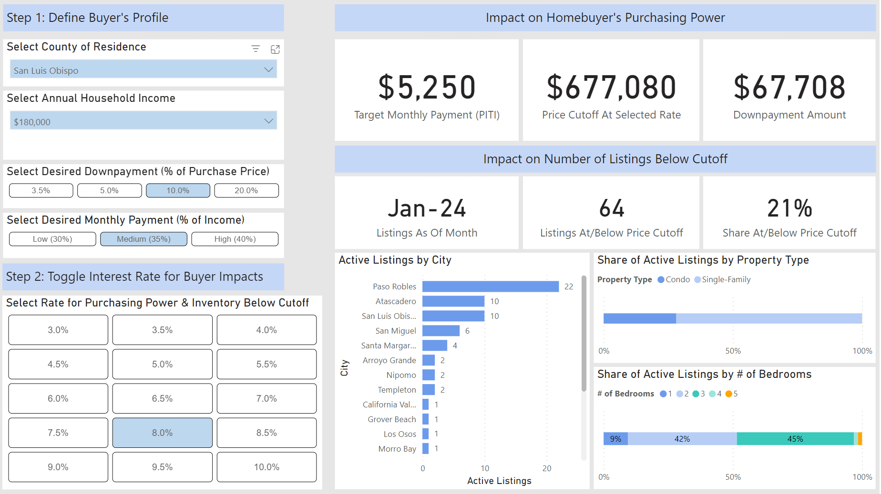

Slide 35
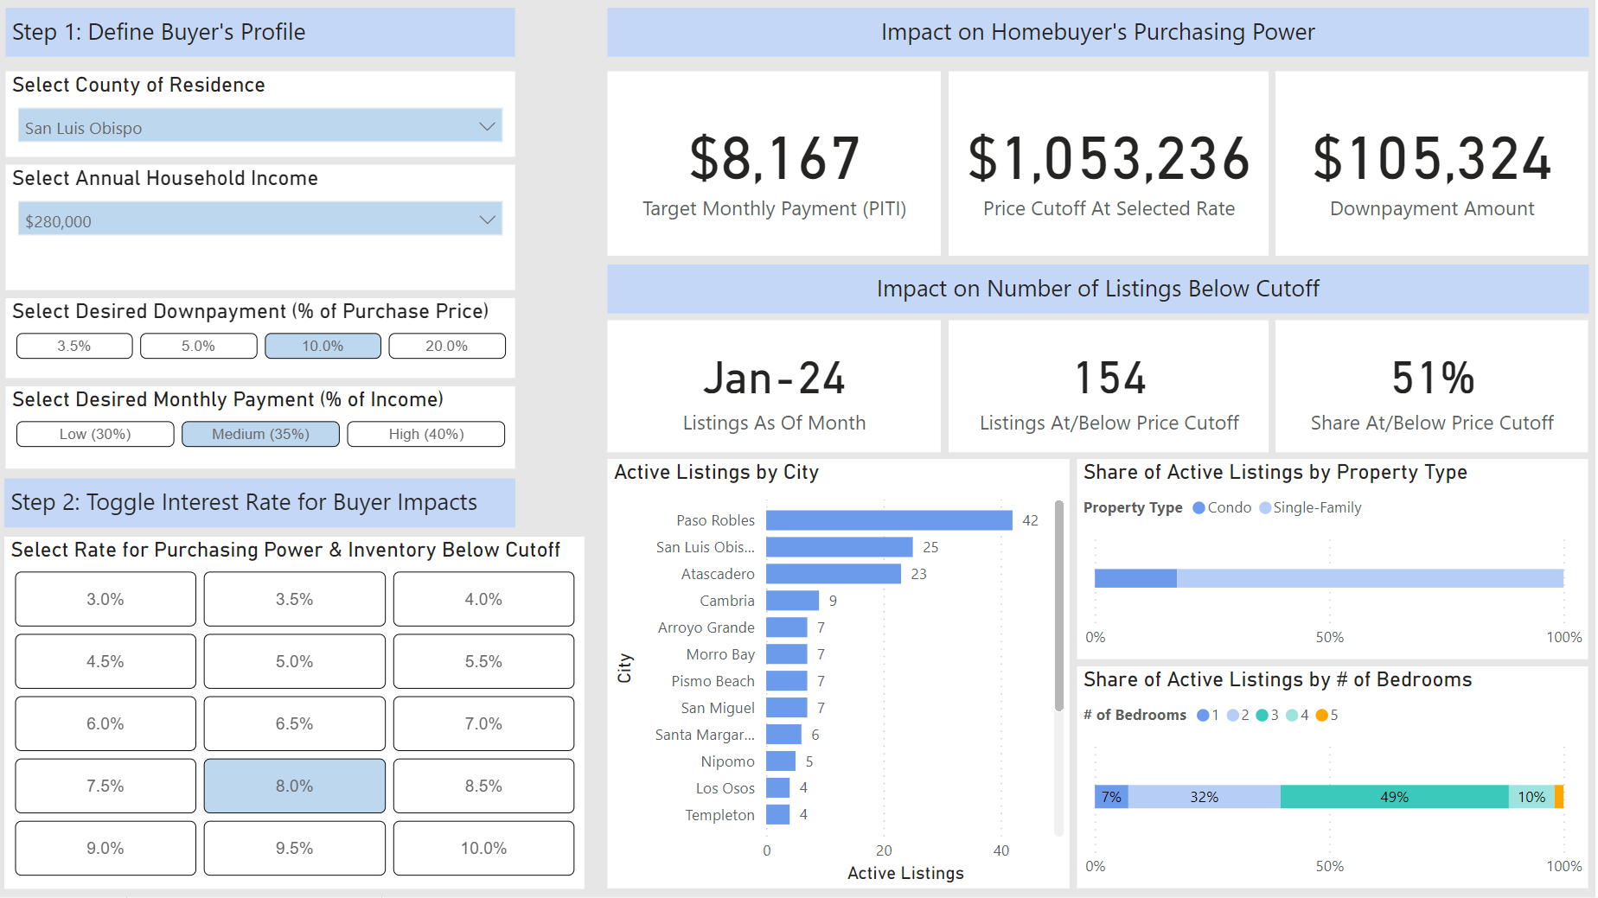

Slide 36
No R-E-O Fire Sales

Slide 37
A lot of home equity preventing REOs AND listings
> 1 out of 3
Less than
20% Equity
95% Have
At Least
20% Equity
Almost 90% Have
At Least
30% Equity

Slide 38
Delinquency currently half of historical average

Slide 39
The benefits of homeownership are well documented

Slide 40
The Forecast for 2024

Slide 41
California housing market outlook
 | 2016 | 2017 | 2018 | 2019 | 2020 | 2021 | 2022 | 2023 | 2024p
SFH Resales (000s) | 417.7 | 424.9 | 402.6 | 398.0 | 411.9 | 444.5 | 342.0 | 257.8 | 291.6
% Change | 2.0% | 1.7% | -5.2% | -1.2% | 3.5% | 7.9% | -23.1% | -24.6% | 13.1%
Median Price ($000s) | $502.3 | $537.9 | $569.5 | $592.4 | $659.4 | $784.3 | $822.3 | $814.0 | $874.2
% Change | 5.4% | 7.1% | 5.9% | 4.0% | 11.3% | 18.9% | 4.5% | -1.0% | 7.4%
Housing Affordability Index | 31% | 29% | 28% | 31% | 32% | 26% | 19% | 17% | 16%
30-Yr FRM | 3.6% | 4.0% | 4.5% | 3.9% | 3.1% | 3.0% | 5.3% | 6.8% | 6.7%

Slide 42
Thank you!!

